Slide 1
Econ 106 Data Analysis in Economics
Lecture 3
Fall 2024
Based on: http://www.datacarpentry.org/R-ecology-lesson/
Notes:
Hi, and welcome R basics. Today we’re going to be discussing how to use the R programming language and the RStudio interface to read and subset tabular data.

Slide 2
Reminders
Research Milestone 1 is posted (not due for a few weeks)
Poll Everywhere will count towards your grade starting this week
grade will be based on the percentage of polls you answer correctly
https://pollev.com/vsovero

Slide 3
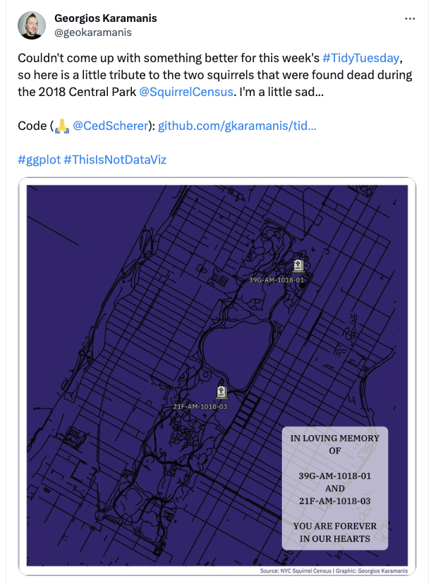
#tidytuesday
https://www.bloomberg.com/news/articles/2019-06-24/how-many-squirrels-are-in-nyc-s-central-park
data: https://github.com/rfordatascience/tidytuesday/tree/master/data/2019/2019-10-29

Slide 4
Outline
Tidyverse basics
Data wrangling with dplyr
Notes:
In brief, we’ll
1. Introduce the R programming language and the RStudio interface
2. Discuss how operators and functions work
3. Investigate the structure of data frames

Slide 5
The tidyverse Package
The most powerful, intuitive, and popular approach to data cleaning, wrangling, and visualization in R
Advantages:
Consistent philosophy and syntax (package is maintained!!!!)
"Verb" based approach makes it more familiar to users of Stata/SAS/SPSS

Slide 6
Packages inside the tidyverse package
lots of packages inside the tidyverse (important ones highlighted)
you won’t need to load these separately in order to use them
"broom" | "conflicted" | "cli" | "dbplyr"
"dplyr" | "dtplyr" | "forcats" | "ggplot2"
"googledrive" | "googlesheets4" | "haven" | "hms"
"httr" | "jsonlite" | "lubridate" | "magrittr"
"modelr" | "pillar" | "purrr" | "ragg"
"readr" | "readxl" | "reprex" | "rlang"
"rstudioapi" | "rvest" | "stringr" | "tibble"
"tidyr" | "xml2" | "tidyverse"

Slide 7
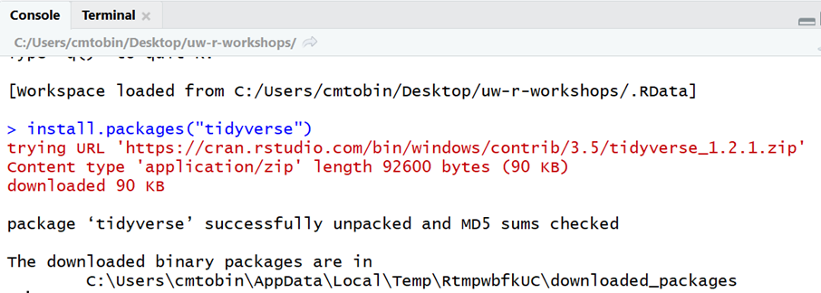
Installing tidyverse package
install.packages("tidyverse")
Output:
Notes:
Before you can use the tidyverse, you need to install the packages
using the install.packages function.
This function will download the packages you need from Comprehensive R Archive Network (CRAN) and store them on your computer where R can find them.
You only need to do this once on each R installation
R packages are not built into the language, but created later by other programmers. In each package, it would provide useful tools, so you don’t have to write it on your own.

Slide 8
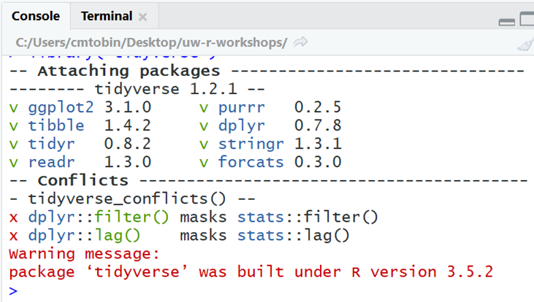
Loading tidyverse package
library("tidyverse")
Output:
Notes:
After you install the package, you are not ready to use it.
Then you need to load the package using the library function.
This function loads the packages so that you can use them
Why the extra step? Having only the packages you need at a given time makes R more efficient.
You need to load packages every time you start RStudio to use the functions they contain.
Let’s load the data and the packages before we learn more about dplyr.
Demo:
install.packages(“tidyverse”)
?read_csv #error
library(“tidyverse”)
?read_csv #help file

Slide 9
Let’s load some new data
We will load the dataset starwars from the tidyverse package
library(tidyverse)
data(starwars)

Slide 10
Dplyr Example
short_characters<- filter(starwars, height<180)
filter() is a dplyr function:
First argument is always a dataframe (no vectors)
second argument describes which variables to operate on
Output: a data frame
Notes:
Now let’s talk about dplyr verbs.
The dplyr functions are very nice and standard. The first argument is always a table.
By running this code, you wouldn’t change the original dataset, it only return a new dataset.
Like any other R function, If you don’t use the assignment operator, the output goes to the console.
To save it, you must use the assignment operator to save the values in a new table name or overwrite the old one.

Slide 11
Pipe operator %>%
Best practice is to put each function on its own line and indent
Use %>% to connect your code to the next line
Say it out loud as “then”
short_characters<- starwars %>%
filter(height<180)
Same as
short_characters<- filter(starwars, height<180)
Notes:
tidyverse verbs can be combined using the pipe operator (%>%).
It would take whatever before it to the next line.
· The operator goes at the end of each line that you want to string together.
· Then the output of the previous line becomes the input for the next line. This works because the output and first input for all dplyr verbs are tables
· This means that you don’t have to explicitly provide the data frame argument in each verb function.
· For example we could specify that we only want records that have weights of less than 5g and only the species_id, sex, and weight columns in one statement.
· Let’s see how pipes work in a demo
Demo 5: pipes
· We can use the assignment operator to save the output in a data frame called surveys_sml
surveys_sml<-surveys %>%
filter(weight<5) %>%
select(species_id, sex, weight)

Slide 12
Key dplyr verbs
**There are five key dplyr verbs**
filter: Filter (i.e. subset) rows based on their values.
arrange: Arrange (i.e. reorder) rows based on their values.
select: Select (i.e. subset) columns by their names:
mutate: Create new columns.
summarize: Collapse multiple rows into a single summary value

Slide 13
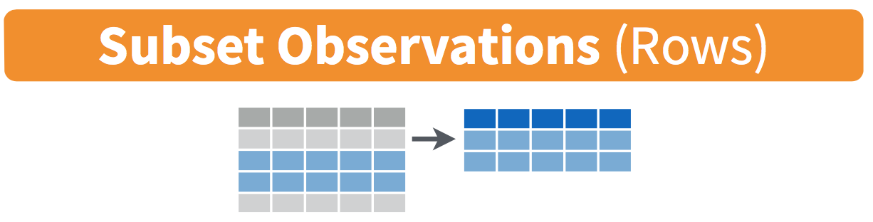
filter()

Slide 14
filter()
Choose rows based on values of a variable
Arguments: data and a logical expression (returns true/false) >, <, >=, <=, ==, !=
Output: data with rows that match the expression
Notes:
We’ve seen how to choose particular columns using select, now let’s look at how to pick rows using filter.
You use filter when you want to look at a subset of your observations, based on certain condition.
· Filter chooses rows based on specified criteria
· It takes a tibble and a logical expression as arguments (== is a logical equal, it compares two values year and 1995, if the answer is yes, it would return TRUE, then this observation would be included in our subset. If the answer is no, this observation would be excluded)
· And it outputs a tibble with only the rows that meet the relational expression
· For example, you can specify that you only want rows where the year is equal to 1995
· Let’s see select in action
Demo 4: filter
# Let’s say we only want to look at records taken in 1995
filter(surveys, year == 1995)
#same as
surveys[surveys$year == 1995, ]
#you can also filter by multiple variables, each condition is separated by a comma
filter(surveys, #the data
year == 1995 & #filter for rows that have 1995 in year column
sex == "F") #filter for rows that have F in the sex column
#same as
surveys[surveys$year == 1995 & surveys$sex == "F", ]

Slide 15
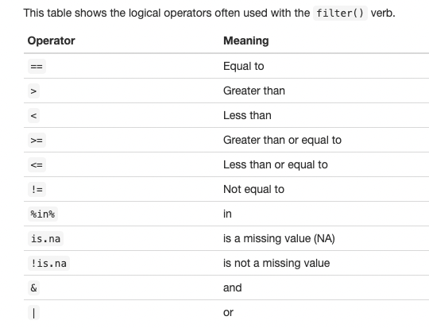
Logical Operators

Slide 16
Combining logical conditions (“and”)
we use the & logical operator when a case has to meet multiple conditions for the same variable
tallish <- starwars %>%
filter(height >= 190 & height <= 250 )
Notes:
We’ve seen how to choose particular columns using select, now let’s look at how to pick rows using filter.
You use filter when you want to look at a subset of your observations, based on certain condition.
· Filter chooses rows based on specified criteria
· It takes a tibble and a logical expression as arguments (== is a logical equal, it compares two values year and 1995, if the answer is yes, it would return TRUE, then this observation would be included in our subset. If the answer is no, this observation would be excluded)
· And it outputs a tibble with only the rows that meet the relational expression
· For example, you can specify that you only want rows where the year is equal to 1995
· Let’s see select in action
Demo 4: filter
# Let’s say we only want to look at records taken in 1995
filter(surveys, year == 1995)
#same as
surveys[surveys$year == 1995, ]
#you can also filter by multiple variables, each condition is separated by a comma
filter(surveys, #the data
year == 1995 & #filter for rows that have 1995 in year column
sex == "F") #filter for rows that have F in the sex column
#same as
surveys[surveys$year == 1995 & surveys$sex == "F", ]

Slide 17
Combining logical conditions (“or”)
we use the | logical operator when our filter has multiple conditions for the same variable
extremes <- starwars %>%
filter(height <= 160 | height >= 190 )
https://pollev.com/vsovero
Notes:
We’ve seen how to choose particular columns using select, now let’s look at how to pick rows using filter.
You use filter when you want to look at a subset of your observations, based on certain condition.
· Filter chooses rows based on specified criteria
· It takes a tibble and a logical expression as arguments (== is a logical equal, it compares two values year and 1995, if the answer is yes, it would return TRUE, then this observation would be included in our subset. If the answer is no, this observation would be excluded)
· And it outputs a tibble with only the rows that meet the relational expression
· For example, you can specify that you only want rows where the year is equal to 1995
· Let’s see select in action
Demo 4: filter
# Let’s say we only want to look at records taken in 1995
filter(surveys, year == 1995)
#same as
surveys[surveys$year == 1995, ]
#you can also filter by multiple variables, each condition is separated by a comma
filter(surveys, #the data
year == 1995 & #filter for rows that have 1995 in year column
sex == "F") #filter for rows that have F in the sex column
#same as
surveys[surveys$year == 1995 & surveys$sex == "F", ]

Slide 18
Exercise
Find the first and third quartile of the mass variable (try using summarize()
Filter for characters who fall within those two values

Slide 19
Filtering with non-numeric variables
If we want to filter based on a non-numeric value, we have to put it in quotes (single or double is fine)
humans<- starwars %>%
filter(species=="Human")

Slide 20
Combining logical conditions
We can also combine logical conditions, same as with numeric variables
blue_black<- starwars %>%
filter(eye_color=="blue" | eye_color=="black")

Slide 21
A Useful trick: %in% logical operator
Helpful when you have a longer list of logical conditions for a non-numeric variable
droid_humans_hutt <- starwars %>%
filter(species %in% c( "Human" , "Droid" , "Hutt" ))

Slide 22
Exercise
What’s wrong with these commands?
mistake1<- starwars %>%
filter(species=="human")
mistake2<- starwars %>%
filter(species=="Human" | "Droid" )
Notes:
We’ve seen how to choose particular columns using select, now let’s look at how to pick rows using filter.
You use filter when you want to look at a subset of your observations, based on certain condition.
· Filter chooses rows based on specified criteria
· It takes a tibble and a logical expression as arguments (== is a logical equal, it compares two values year and 1995, if the answer is yes, it would return TRUE, then this observation would be included in our subset. If the answer is no, this observation would be excluded)
· And it outputs a tibble with only the rows that meet the relational expression
· For example, you can specify that you only want rows where the year is equal to 1995
· Let’s see select in action
Demo 4: filter
# Let’s say we only want to look at records taken in 1995
filter(surveys, year == 1995)
#same as
surveys[surveys$year == 1995, ]
#you can also filter by multiple variables, each condition is separated by a comma
filter(surveys, #the data
year == 1995 & #filter for rows that have 1995 in year column
sex == "F") #filter for rows that have F in the sex column
#same as
surveys[surveys$year == 1995 & surveys$sex == "F", ]

Slide 23
https://pollev.com/vsovero

Slide 24
“not” logical operator
sometimes it’s easier to filter for what you don’t want
we use the ! logical operator
not_human<- starwars %>%
filter(species!="Human")

Slide 25
filter() and missing data
A very common filter use case is identifying (or removing) missing data cases.
These examples use is.na (“is missing”) and ! (“not”)
missing_heights <- starwars %>%
filter(is.na(height))
non_missing_heights <- starwars %>%
filter(!is.na(height))
Notes:
We’ve seen how to choose particular columns using select, now let’s look at how to pick rows using filter.
You use filter when you want to look at a subset of your observations, based on certain condition.
· Filter chooses rows based on specified criteria
· It takes a tibble and a logical expression as arguments (== is a logical equal, it compares two values year and 1995, if the answer is yes, it would return TRUE, then this observation would be included in our subset. If the answer is no, this observation would be excluded)
· And it outputs a tibble with only the rows that meet the relational expression
· For example, you can specify that you only want rows where the year is equal to 1995
· Let’s see select in action
Demo 4: filter
# Let’s say we only want to look at records taken in 1995
filter(surveys, year == 1995)
#same as
surveys[surveys$year == 1995, ]
#you can also filter by multiple variables, each condition is separated by a comma
filter(surveys, #the data
year == 1995 & #filter for rows that have 1995 in year column
sex == "F") #filter for rows that have F in the sex column
#same as
surveys[surveys$year == 1995 & surveys$sex == "F", ]

Slide 26
Exercise
create a data frame of the characters whose sex is listed as none
create a data frame of the characters whose sex is unknown (missing)

Slide 27
filter()
We can chain multiple filter commands with the pipe %>%
we can also separate them within a single filter command using commas.
tall_humans <- starwars %>%
filter(species=="Human") %>%
filter(height >= 190)
tall_humans <- starwars %>%
filter(species=="Human", height >= 190)
Notes:
We’ve seen how to choose particular columns using select, now let’s look at how to pick rows using filter.
You use filter when you want to look at a subset of your observations, based on certain condition.
· Filter chooses rows based on specified criteria
· It takes a tibble and a logical expression as arguments (== is a logical equal, it compares two values year and 1995, if the answer is yes, it would return TRUE, then this observation would be included in our subset. If the answer is no, this observation would be excluded)
· And it outputs a tibble with only the rows that meet the relational expression
· For example, you can specify that you only want rows where the year is equal to 1995
· Let’s see select in action
Demo 4: filter
# Let’s say we only want to look at records taken in 1995
filter(surveys, year == 1995)
#same as
surveys[surveys$year == 1995, ]
#you can also filter by multiple variables, each condition is separated by a comma
filter(surveys, #the data
year == 1995 & #filter for rows that have 1995 in year column
sex == "F") #filter for rows that have F in the sex column
#same as
surveys[surveys$year == 1995 & surveys$sex == "F", ]

Slide 28
https://pollev.com/vsovero

Slide 29
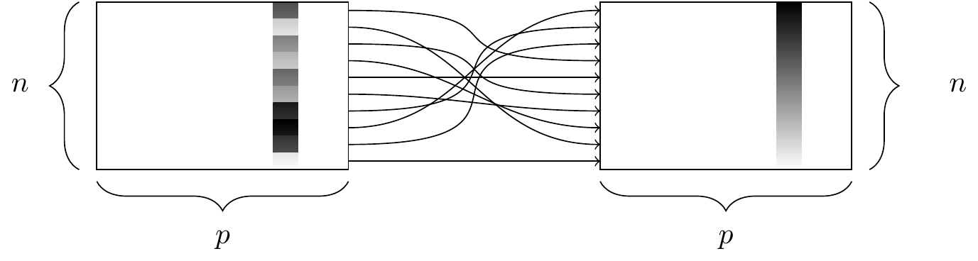
arrange()
Notes:
When making these summary tables, the data don’t always appear in the order that we would like.
The arrange() function orders the results in ascending order
It takes a variable as input
If you want to arrange them in descending order, wrap the variable name in the desc() function
The output is a table with the same data, but ordered in the way you specified.
Let’s see how this works:
Demo:
#Ascending order
surveys %>%
count(sex) %>%
arrange(n)
#descending order
surveys %>%
count(sex) %>%
arrange(desc(n))

Slide 30
arrange()
arrange() sorts your data frame by a particular variable in ascending order :
numeric: 1,2,3, etc.
character: a, b, c, etc.
Arguments:
A variable
Use desc() to put them in descending order
ascending_birth_year<- starwars %>%
arrange(birth_year)
descending_birth_year<- starwars %>%
arrange( desc(birth_year))
Notes:
When making these summary tables, the data don’t always appear in the order that we would like.
The arrange() function orders the results in ascending order
It takes a variable as input
If you want to arrange them in descending order, wrap the variable name in the desc() function
The output is a table with the same data, but ordered in the way you specified.
Let’s see how this works:
Demo:
#Ascending order
surveys %>%
count(sex) %>%
arrange(n)
#descending order
surveys %>%
count(sex) %>%
arrange(desc(n))

Slide 31
Exercise
Who is the tallest character in Naboo?

Slide 32
https://pollev.com/vsovero

Slide 33
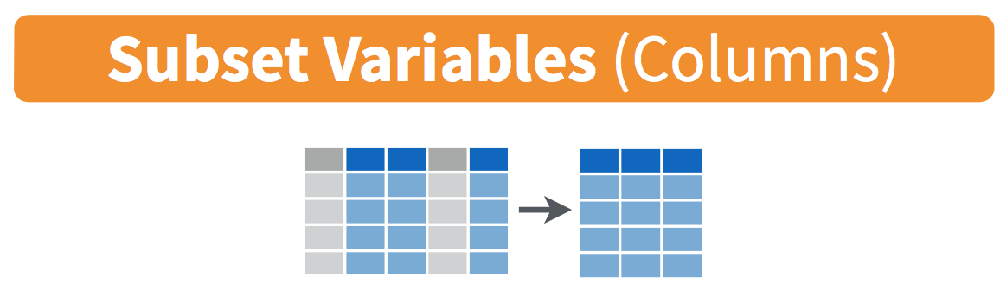
select()
Notes:
Now that we have the data loaded, let’s manipulate it with our first verb: select
Select picks columns from a data frame
It takes a tibble and a list of column names as input
And its output is a tibble with only the columns you selected
Let’s see an example of how select works
Demo 3: select
select(surveys,
weight)
You can also use –weight, keep everything but exclude weight column.
Same as:
tibble(surveys$weight)
#You can also select multiple columns by separating other column names with a comma.
#Let’s say we have a collaborator who only wants the plot, species id, and weight data
select(surveys, plot_id, species_id, weight)

Slide 34
select()
select() selects variables from a data frame
Arguments:
variables to be kept (separated by commas)
Output: data with only the specified variables
fewer_vars1<- starwars %>%
select(mass, species, height)
Notes:
Now that we have the data loaded, let’s manipulate it with our first verb: select
Select picks columns from a data frame
It takes a tibble and a list of column names as input
And its output is a tibble with only the columns you selected
Let’s see an example of how select works
Demo 3: select
select(surveys,
weight)
You can also use –weight, keep everything but exclude weight column.
Same as:
tibble(surveys$weight)
#You can also select multiple columns by separating other column names with a comma.
#Let’s say we have a collaborator who only wants the plot, species id, and weight data
select(surveys, plot_id, species_id, weight)

Slide 35
https://pollev.com/vsovero

Slide 36
select()
You can also use "first:last" to select consecutive columns.
Deselect a column with "-".
fewer_vars<- starwars %>%
select(height:eye_color, -skin_color)
Notes:
select(surveys,
weight)
You can also use –weight, keep everything but exclude weight column
Same as: tibble(surveys$weight)
#You can also select multiple columns by separating other column names with a comma
#Let’s say we have a collaborator who only wants the plot, species id and weight data
select(surveys, plot_id, species_id, weight)

Slide 37
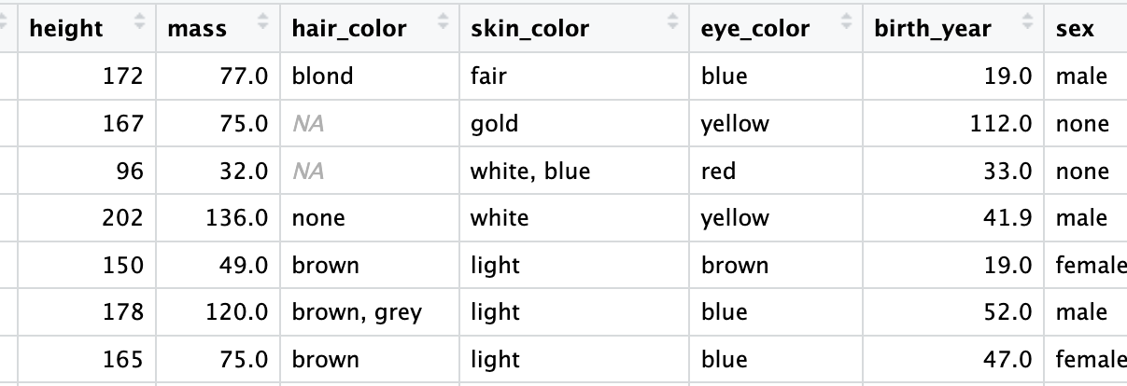
select()
fewer_vars<- starwars %>%
select(height:eye_color, -skin_color)
Notes:
select(surveys,
weight)
You can also use –weight, keep everything but exclude weight column
Same as: tibble(surveys$weight)
#You can also select multiple columns by separating other column names with a comma
#Let’s say we have a collaborator who only wants the plot, species id and weight data
select(surveys, plot_id, species_id, weight)

Slide 38
select() variable names that match a pattern
color_vars<- starwars %>%
select(contains("color"))
Notes:
select(surveys,
weight)
You can also use –weight, keep everything but exclude weight column
Same as: tibble(surveys$weight)
#You can also select multiple columns by separating other column names with a comma
#Let’s say we have a collaborator who only wants the plot, species id and weight data
select(surveys, plot_id, species_id, weight)

Slide 39
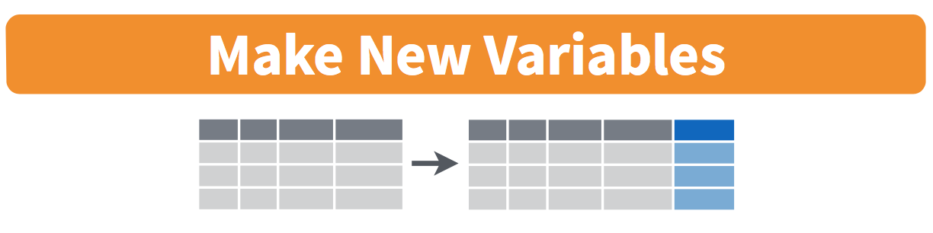
mutate()
Notes:
dplyr also allows you to create new columns using the mutate function
· Which creates a new column as defined by the input
· Mutate takes a tibble and an expression that names and defines the value of the new column
· This function outputs a tibble that includes the new column as defined in the input
· For example, the weight is currently in grams. We could create a new column called weight_kg that stores the weight in kilograms
· Let’s see how this works in practice
Demo 6:
To create a new column with mutate…
mutate(surveys, weight_kg = weight/1000)
same as
surveys %>%
mutate(weight_kg = weight/1000)

Slide 40
mutate()
Creates a new variable
Arguments: data frame and the definition of a new variable
Output: data frame with a new variable
Notes:
dplyr also allows you to create new columns using the mutate function
· Which creates a new column as defined by the input
· Mutate takes a tibble and an expression that names and defines the value of the new column
· This function outputs a tibble that includes the new column as defined in the input
· For example, the weight is currently in grams. We could create a new column called weight_kg that stores the weight in kilograms
· Let’s see how this works in practice
Demo 6:
To create a new column with mutate…
mutate(surveys, weight_kg = weight/1000)
same as
surveys %>%
mutate(weight_kg = weight/1000)

Slide 41
mutate()
You can create multiple new variables at a time with pipes (first example)
You can also skip the pipes and put a comma instead (second example)
add_new_vars<- starwars %>%
mutate(dog_years=birth_year*7) %>%
mutate(height_m=height/100)
add_new_vars<- starwars %>%
mutate(dog_years=birth_year*7,
height_m=height/100)
Notes:
dplyr also allows you to create new columns using the mutate function
· Which creates a new column as defined by the input
· Mutate takes a tibble and an expression that names and defines the value of the new column
· This function outputs a tibble that includes the new column as defined in the input
· For example, the weight is currently in grams. We could create a new column called weight_kg that stores the weight in kilograms
· Let’s see how this works in practice
Demo 6:
To create a new column with mutate…
mutate(surveys, weight_kg = weight/1000)
same as
surveys %>%
mutate(weight_kg = weight/1000)

Slide 42
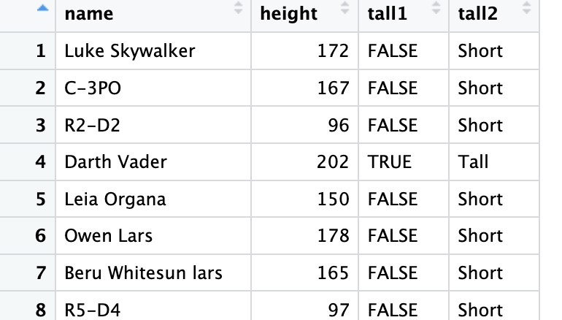
mutate()
We can also create non-numeric vectors with mutate
add_height_vars<- starwars %>%
select(name, height) %>%
mutate(tall1 = height > 180,
tall2 = ifelse(height > 180, "Tall", "Short"))
Notes:
dplyr also allows you to create new columns using the mutate function
· Which creates a new column as defined by the input
· Mutate takes a tibble and an expression that names and defines the value of the new column
· This function outputs a tibble that includes the new column as defined in the input
· For example, the weight is currently in grams. We could create a new column called weight_kg that stores the weight in kilograms
· Let’s see how this works in practice
Demo 6:
To create a new column with mutate…
mutate(surveys, weight_kg = weight/1000)
same as
surveys %>%
mutate(weight_kg = weight/1000)

Slide 43
Be careful with the order of chained commands
Why doesn’t this work?
hmm<- starwars %>%
select(name, mass) %>%
arrange( height)

Slide 44
Exercise
Calculate the BMI of the star wars characters (height divided by mass squared)
filter for non-human characters
sort the data from highest to lowest BMI

